Slide 1


KANCHANA S.
2023/09/19

Slide 2

Outline
Executive Summary
Introduction
Methodology
Results
Conclusion
Appendix

Slide 3
Executive Summary
Summary of methodologies
Data Collection through API
Data Collection with Web Scraping
Data Wrangling
Exploratory Data Analysis with SQL
Exploratory Data Analysis with Data Visualization
Interactive Visual Analytics with Folium
Machine Learning Prediction
Summary of all results
Exploratory Data Analysis results
Interactive analytics demo in screenshots
Predictive analysis results

Slide 4
Introduction
Project background and context
SpaceX is the most successful company of the commercial space age, making space travel affordable. The company advertises Falcon 9 rocket launches on its website, with a cost of 62 million dollars; other providers cost upward of 165 million dollars each, much of the savings is because SpaceX can reuse the first stage. Therefore, if we can determine if the first stage will land, we can determine the cost of a launch. Based on public information and machine learning models, we are going to predict if SpaceX will reuse the first stage
Problems you want to find answers
How do variables such as payload mass, launch site, number of flights, and orbits affect the success of the first stage landing?
Does the rate of successful landings increase over the years?
What is the best algorithm that can be used for binary classification in this case?

Slide 5

Section 1

Slide 6
Methodology
Executive Summary
Data collection methodology:
Using SpaceX Rest API
Using Web Scrapping
Perform data wrangling
Using One Hot Encoding
Perform exploratory data analysis (EDA) using visualization and SQL
Perform interactive visual analytics using Folium and Plotly Dash
Perform predictive analysis using classification models
Building, tuning and evaluation of classification models to ensure the best results

Slide 7
Data Collection
Understand its content,
Assess its quality,
Discover any interesting preliminary insights, and,
Determine whether additional data is necessary to fill any gaps in the data.

Slide 8


Data Collection – SpaceX API
Present your data collection with SpaceX REST calls using key phrases and flowcharts
Add the GitHub URL of the completed SpaceX API calls notebook (must include completed code cell and outcome cell), as an external reference and peer-review purpose
Use SpaceX API
Get HTML response from Wikipedia
Return SpaceX data in .JSON
Extract data to BeautifulSoup
Normalize data to .CSV file
Normalize data to .CSV file
Ready for data consolidation & wrangling

Slide 9
Data Collection - Scraping
Present your web scraping process using key phrases and flowcharts
Add the GitHub URL of the completed web scraping notebook, as an external reference and peer-review purpose
1. Getting response from HTML
5. Dictionary creation
2. Creating BeautifulSoup object
6. Appending data to keys
3. Finding tables
7. Converting dictionary to dataframe
4. Get column names
8. Converting dataframe to .CSV

Slide 10
Data Wrangling
Perform exploratory Data Analysis and determine Training Labels
Calculate the number of launches on each site
Calculate the number and occurrence of each orbit
Calculate the number and occurrence of mission outcome per orbit type
Create a landing outcome label from Outcome column
Exporting the data to .CSV

Slide 11
EDA with Data Visualization
There are various types of plots commonly used in data visualization.
Line plots capture trends and changes over time, allowing us to see patterns and fluctuations.
Bar plots compare categories or groups, providing a visual comparison of their values.
Scatter plots explore relationships between variables, helping us identify correlations or trends.
Box plots display the distribution of data, showcasing the median, quartiles, and outliers.

Slide 12
EDA with SQL
Use Data Manipulation Language (DML) statements to read and modify data.
The search condition of the WHERE clause uses a predicate to refine the search.
COUNT, DISTINCT, and LIMIT are expressions that are used with SELECT statements.
INSERT, UPDATE, and DELETE are DML statements for populating and changing tables.

Slide 13
Build an Interactive Map with Folium
Folium is a data visualization library in Python that helps people visualize geospatial data.
With Folium, you can create maps of different styles, such as street-level maps, stamen maps, and more.
A feature of Folium is that you can create different map styles using the tiles parameter.
With Folium, you can easily add markers on maps.
The ‘location’ parameter specifies the latitude and longitude coordinates of the center point of the map.
Markers play a vital role in enhancing interactivity and adding context to maps.
The folium.Marker() function specifies location parameters.
The popup parameter provides a label upon being clicked.
Markers can be created using “feature group.”
A choropleth map is a thematic map in which areas are shaded or patterned in proportion to the measurement of the statistical variable.
When creating a choropleth map, Folium requires a GeoJson file that includes geospatial data of the region.
The Mapbox Bright Tileset displays the name of every country when used on a map.

Slide 14
Build a Dashboard with Plotly Dash
Dash is an Open-Source User Interface Python library for creating reactive, web-based applications.
It is easy to build Graphical User Interfaces using Dash as it abstracts all technologies required to make the applications.
There are two components of Dash: Core and HTML components.
The dash_core_components describe higher-level interactive components generated with JavaScript, HTML, and CSS through the React.js library.
The dash_html_components library has a component for every HTML tag.
A callback function is a python function that is automatically called by Dash whenever an input component's property changes.
The @app.callback decorator decorates the callback function in order to tell Dash to call it whenever there is a change in the input component value.
The callback function takes input and output components as parameters and performs operations to return the desired result for the output component.

Slide 15
Predictive Analysis (Classification)
Define the explanatory variable and the response variable: Define the response variable (y) as the focus of the experiment and the explanatory variable (x) as a variable used to explain the change of the response variable. Understand the differences between Simple Linear Regression because it concerns the study of only one explanatory variable and Multiple Linear Regression because it concerns the study of two or more explanatory variables.
Evaluate the model using Visualization: By visually representing the errors of a variable using scatterplots and interpreting the results of the model.
Identify alternative regression approaches: Use a Polynomial Regression when the Linear regression does not capture the curvilinear relationship between variables and how to pick the optimal order to use in a model.
Interpret the R-square and the Mean Square Error: Interpret R-square (x 100) as the percentage of the variation in the response variable y that is explained by the variation in explanatory variable(s) x. The Mean Squared Error tells you how close a regression line is to a set of points. It does this by taking the average distances from the actual points to the predicted points and squaring them.

Slide 16
Results
Exploratory data analysis results
Interactive analytics demo in screenshots
Predictive analysis results

Slide 17

Section 2

Slide 18

Flight Number vs. Launch Site
From the plot, we found that the larger the flight amount at a launch site, the greater the success rate at a launch site.

Slide 19
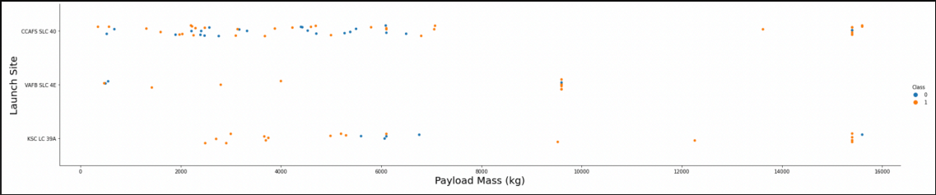
Payload vs. Launch Site
Explanation:
• For every launch site the higher the payload mass, the higher the success rate.
• Most of the launches with payload mass over 7000 kg were successful.
• KSC LC 39A has a 100% success rate for payload mass under 5500 kg too

Slide 20

Success Rate vs. Orbit Type
Explanation:
Orbits with 100% success rate:
ES-L1, GEO, HEO, SSO
Orbits with 0% success rate:
SO
Orbits with success rate between 50% and 85%:
GTO, ISS, LEO, MEO, PO

Slide 21

Flight Number vs. Orbit Type
Explanation:
In the LEO orbit the Success appears related to the number of flights; on the other hand, there seems to be no relationship between flight number when in GTO orbit. Show the screenshot of the scatter plot with explanations

Slide 22

Payload vs. Orbit Type
Explanation:
Heavy payloads have a negative influence on GTO orbits and positive on GTO and Polar LEO (ISS) orbits. Show the screenshot of the scatter plot with explanations

Slide 23

Launch Success Yearly Trend
Explanation:
The success rate since 2013 kept increasing till 2020.

Slide 24
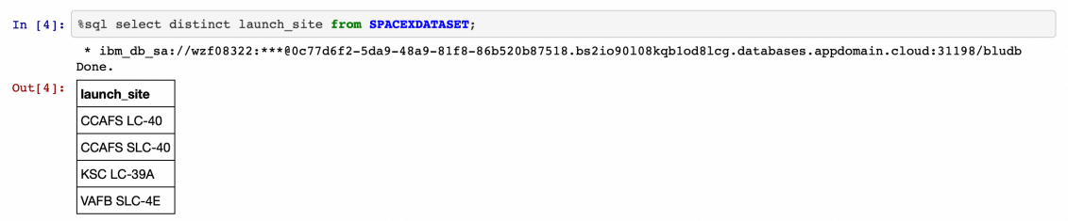
All Launch Site Names
Used the key word DISTINCT to show only unique launch sites from the SpaceX data.

Slide 25
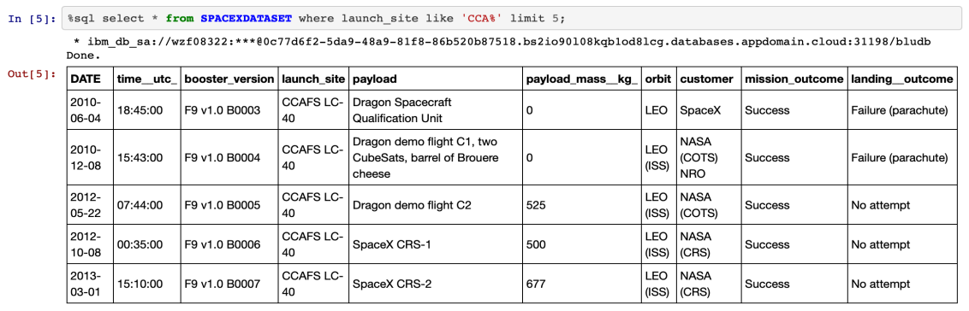
Launch Site Names Begin with 'CCA'
5 records where launch sites begin with `CCA`

Slide 26

Total Payload Mass
The total payload carried by boosters from NASA

Slide 27

Average Payload Mass by F9 v1.1
The average payload mass carried by booster version F9 v1.1

Slide 28

First Successful Ground Landing Date
The dates of the first successful landing outcome on ground pad

Slide 29

Successful Drone Ship Landing with Payload between 4000 and 6000
List the names of boosters which have successfully landed on drone ship and had payload mass greater than 4000 but less than 6000

Slide 30

Total Number of Successful and Failure Mission Outcomes
The total number of successful and failure mission outcomes

Slide 31

Boosters Carried Maximum Payload
The names of the booster which have carried the maximum payload mass

Slide 32

2015 Launch Records
The failed landingoutcomes in drone ship, their booster versions, and launch site names for in year 2015

Slide 33

Rank Landing Outcomes Between 2010-06-04 and 2017-03-20
Rank the count of landing outcomes (such as Failure (drone ship) or Success (ground pad)) between the date 2010-06-04 and 2017-03-20, in descending order

Slide 34

Section 3

Slide 35

All launch sites global map markers

Slide 36

Markers showing launch sites with color labels

Slide 37

Launch Site distance to landmarks

Slide 38

Section 4

Slide 39

Pie chart showing the success percentage achieved by each launch site

Slide 40

Pie chart showing the Launch site with the highest launch success ratio

Slide 41

Scatter plot of Payload vs Launch Outcome for all sites, with different payload selected in the range slider

Slide 42

Section 5

Slide 43
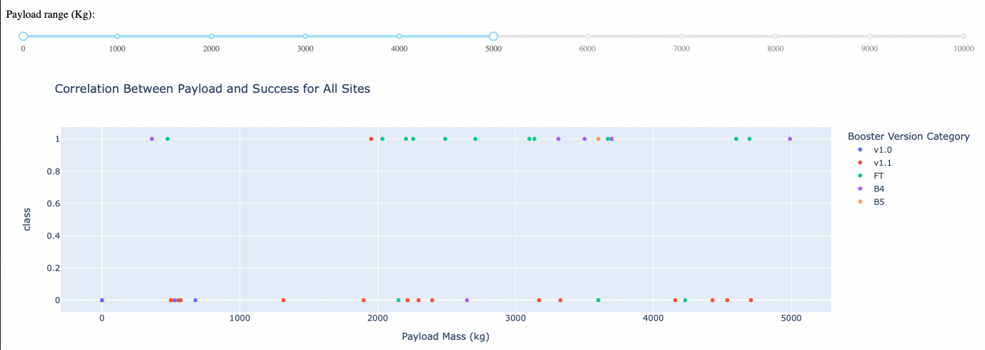
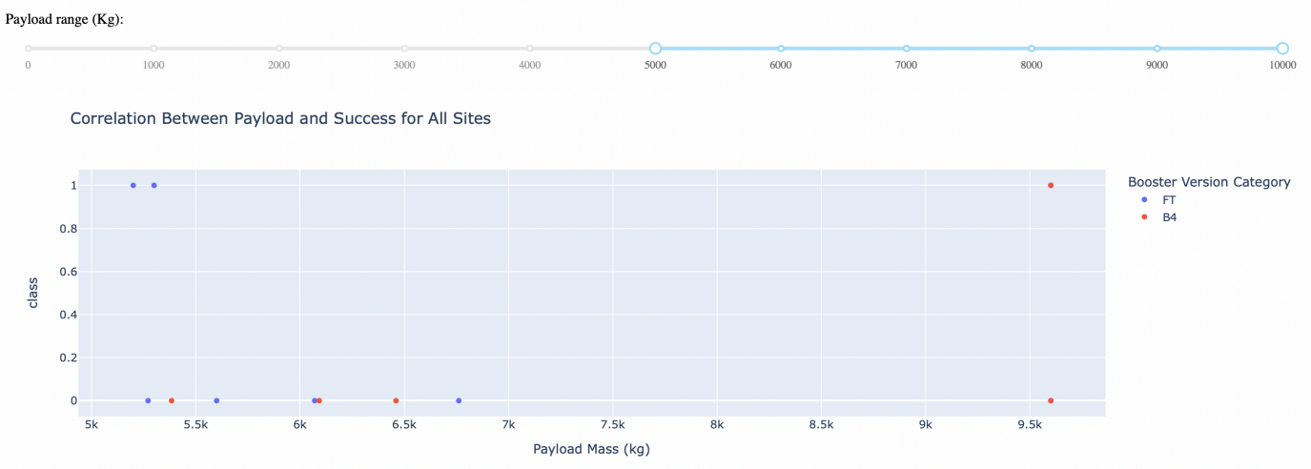
Classification Accuracy
Explanation:
• The charts show that payloads between 2000 and 5500kg have the highest success rate.

Slide 44

Confusion Matrix
Explanation:
Examining the confusion matrix, we see that logistic regression can distinguish between the different classes. We see that the major problem is false positives

Slide 45
Conclusions
Decision Tree Model is the best algorithm for this dataset.
Launches with a low payload mass show better results than launches with a larger payload mass.
Most of launch sites are in proximity to the Equator line and all the sites are in very close proximity to the coast.
The success rate of launches increases over the years.
KSC LC-39A has the highest success rate of the launches from all the sites.
Orbits ES-L1, GEO, HEO and SSO have 100% success rate.

Slide 46
Appendix
https://github.com/kanchanaduck/Applied-Data-Science-Capstone.git

Slide 47


